Slide 1
3.2 Introduction to Email

Slide 2
Objectives
Create an online email account
Create a secure password
Write, open, reply, send, and forward email messages
Add contacts to a contact list
Send and open attachments

Slide 3
Email Vs Snail Mail
Email | Snail Mail
Send messages instantly | Messages arrive after 2-3 days
Access anywhere | Fixed physical address
Free (with internet access) | Cost of postage

Slide 4
Other Advantages
Other tools (calendar, contact list, chat)
Private (password protected)
Access other parts of the web
Send emails to large numbers of people at once
More than just text: share pictures and other files
Easy to organize

Slide 5
Anatomy of an email address
GaryGlassjaw@gmail.com
Username
at
Email
Provider

Slide 6



Webmail

Slide 7
Email Lingo
Send
Reply
Forward
Inbox
CC/BCC
Attachment
Contact list
Filter
Delete
Spam

Slide 8
Passwords
Make your password difficult to guess
Don’t use your dog’s name, birthday, or complete words
Use capital and lowercase letters, numbers, and symbols such as !@#$%^&*()
Longer is better (8 or more characters)
Never tell anyone your password
Know how to recover your password

Slide 9

Email Etiquette
Reply vs. reply all
Greeting and closing/Subject line
Consider your readers
Spell check
Formatting
DON’T TYPE IN ALL CAPS
Protect privacy with BCC

Slide 10
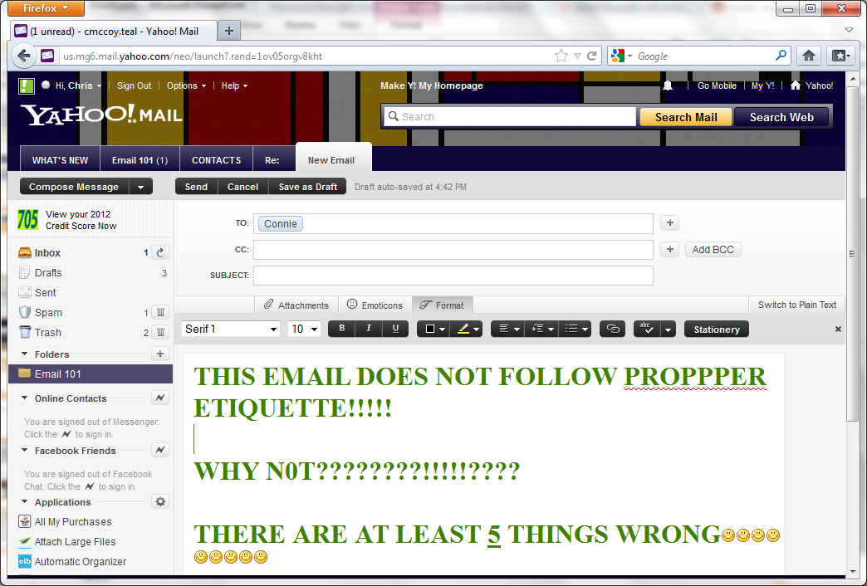
Etiquette Example

Slide 11
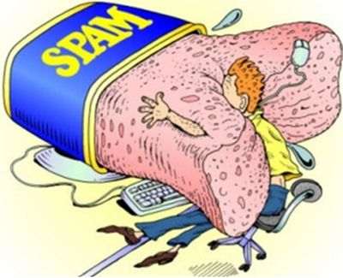
Spam
STOP SPAM:
Never reply to spam
Spam filter
Separate email accounts
Give out your email to those you trust

Slide 12
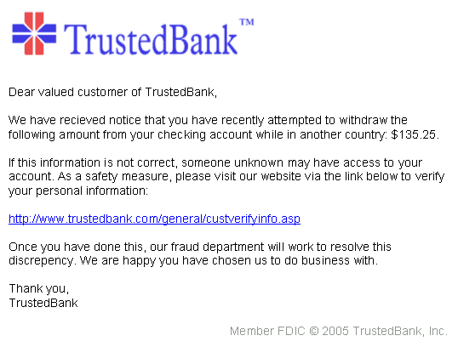
Phishing

Slide 13



Beyond Email

Slide 14


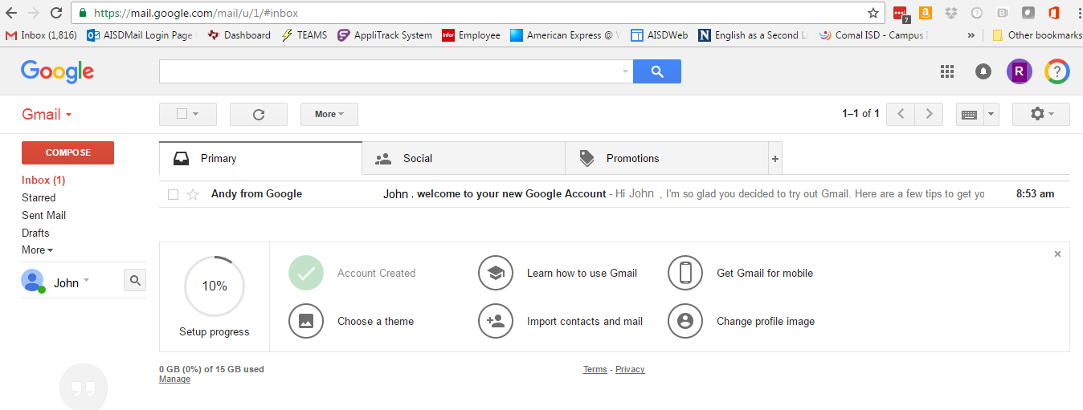
Inbox Example
Inbox

Slide 15
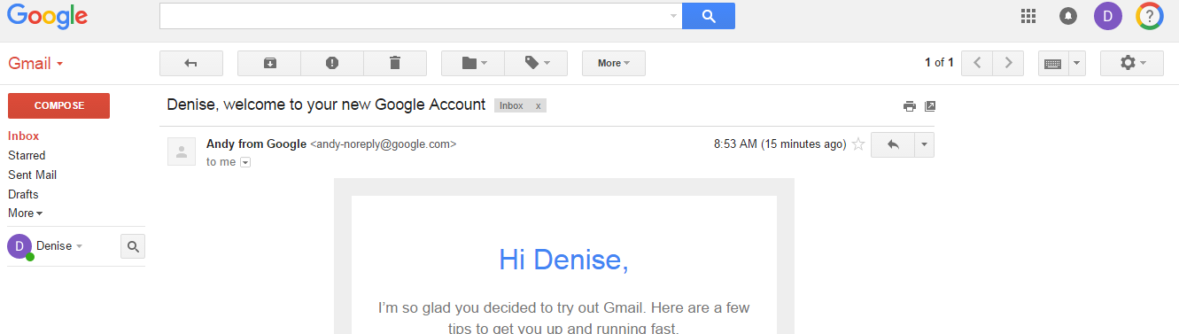
Email Message Window Example
Email Message Window

Slide 16
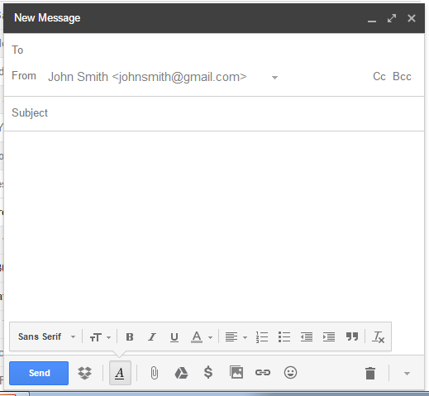
Compose Window Example
Header
Compose Window
Body
Formatting
Actions

Slide 17
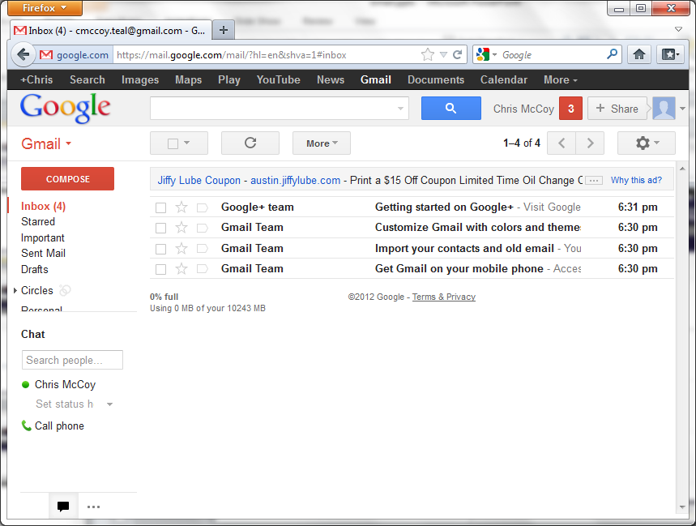
Search Example
Search
Inbox
Side Bar

Slide 18
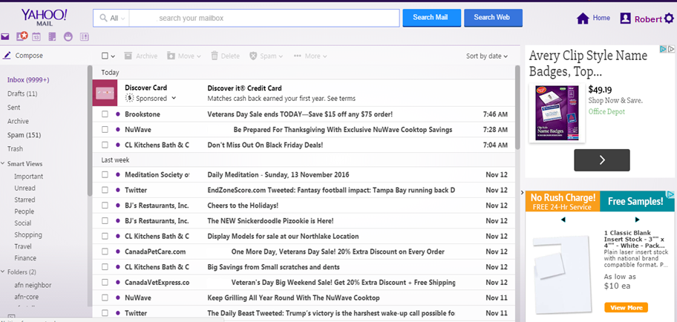
Yahoo Example
The Yahoo Look

Slide 19
Hands-On Email
Hands-on Email
3.0.2 Creating an Email Account
3.0.3 Writing and Sending an Email
3.0.4 Reading and Replying to an Email
3.0.5 Forwarding an Email
3.0.6 Sending an Attachment
3.0.7 Opening an Attachment
3.0.8 Adding Contacts

